Slide 1
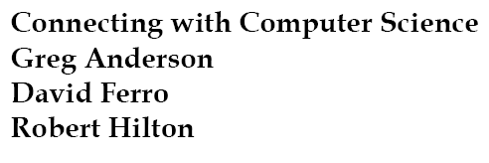
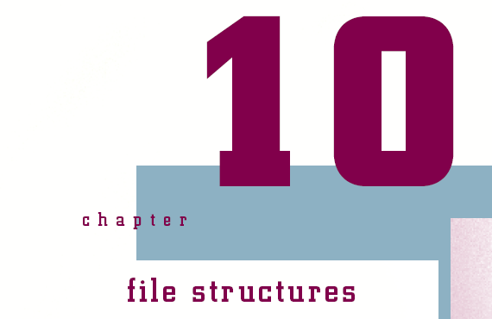

Slide 2
Objectives
Learn what a file system does
Understand the FAT file system and its advantages and disadvantages
Understand the NTFS file system and its advantages and disadvantages
Compare various file systems

Slide 3
Objectives (continued)
Learn how sequential and random file access work
See how hashing is used
Understand how hashing algorithms are created

Slide 4
What Does a File System Do?
Responsible for creating, manipulating, renaming, copying, and removing files to and from a storage device
Organizes files into common storage units called directories
Keeps track of where files and directories are located
Assists users by relating files and folders to the physical structure of the storage medium

Slide 5
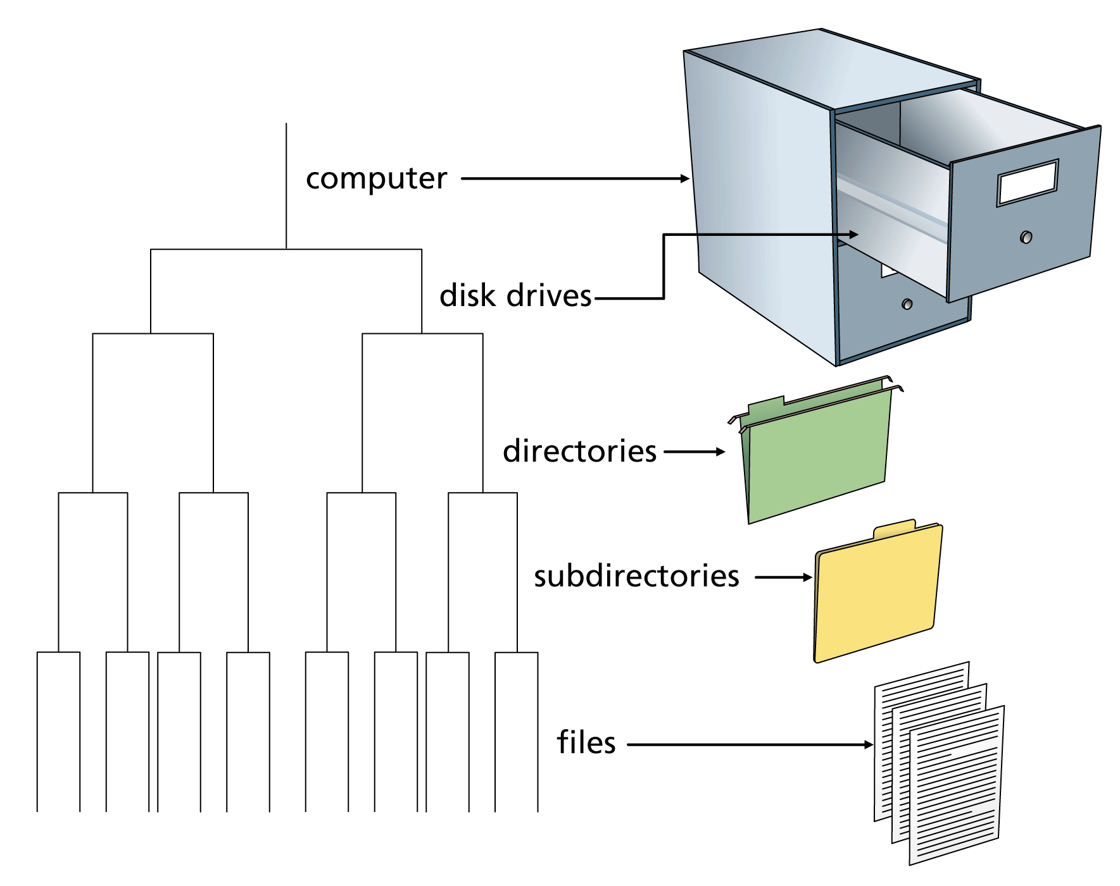
Figure 10-1: Files and directories in a file system are similar to documents and folders in a filing cabinet

Slide 6
Storage Mediums
A hard disk, or drive, is the most common storage medium for a file system
  Physically organized into tracks and sectors
  Read/write heads move over specified areas of the hard disks to store (write) or retrieve (read) data
  Random access device
    Can read or write data directly anywhere on the disk
    Faster than sequential access, which reads and writes from beginning to end
    Makes use of the file system to organize files

Slide 7
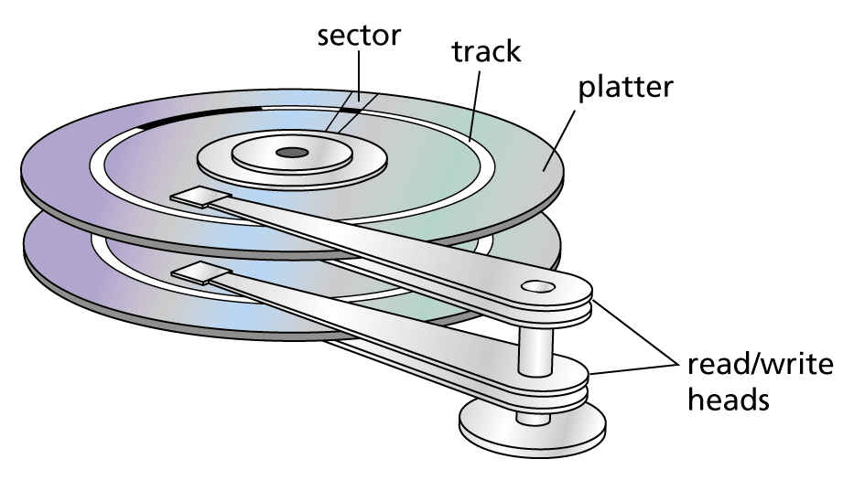
Figure 10-3
Hard disk platters are divided into tracks and sectors and
read/write heads store and retrieve data

Slide 8
File Systems and Operating Systems
The type of file management system is dependent on the operating system
  FAT (file allocation table)
    Used from MS-DOS to Windows ME
  NTFS (New Technology File System)
    Default for Windows NT through Windows 2003
  Unix and Linux support several file systems
    XFS, JFS, ReiserFS, ext3, and others
  HFS+
    The current Mac OS X file system

Slide 9
FAT
Groups hard drive sectors into clusters
  Increases performance by organizing blocks of sectors contiguously
Maintains the relationship between files and clusters being used for the file
  Clusters have two entries in the table
    Current cluster information
    Link to the next cluster or a special code indicating it is the last cluster
Keeps track of writable clusters and bad clusters

Slide 10
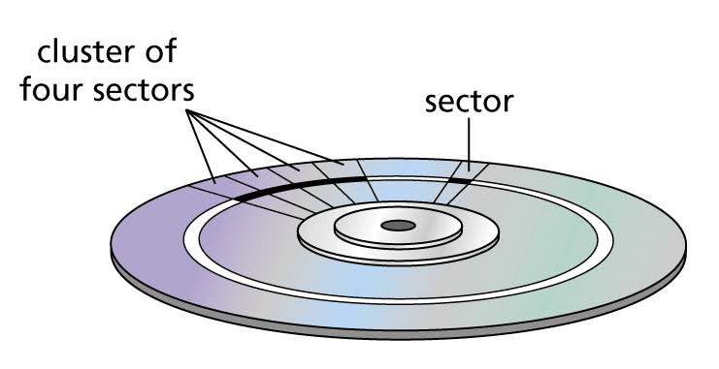
Figure 10-4
Sectors are grouped into clusters on a hard disk

Slide 11
FAT (continued)
Organizes the hard drive into
  Partition boot record
    Contains information on how to access the volume with a file system
  Main and backup FAT
    If an error occurs in reading the main FAT, the backup is copied to the main to ensure stability
  Root directory
    Contains entries for every file and folder in the directory

Slide 12
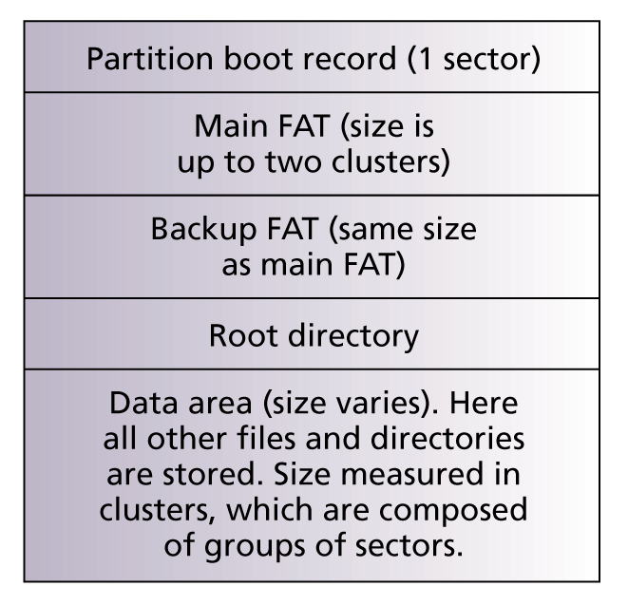
Figure 10-5
Typical FAT file system

Slide 13
Defragmentation
Occurs when files have clusters scattered in different locations on the storage medium rather than in a contiguous location
Windows provides the Disk Defragmenter utility to reorganize clusters contiguously
  Improves performance by minimizing movement of the read/write heads
  Should be used regularly to ensure system runs at peak performance

Slide 14
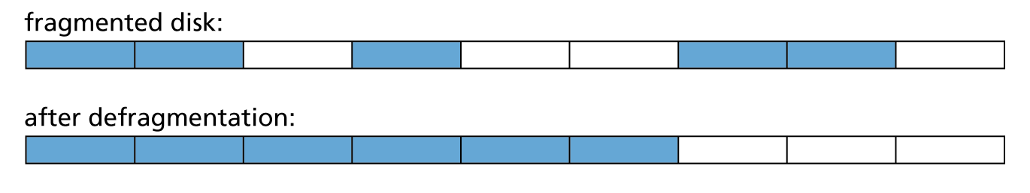
Figure 10-6
Files become fragmented as they are stored in noncontiguous clusters; a defragmenting utility moves files to contiguous clusters and improves disk performance

Slide 15
Advantages of FAT
Efficient use of disk space
  Does not have to use contiguous space for large files
File names (FAT32) can have up to 255 characters
Easy to undelete files that have been deleted
  When a file is deleted, the system places a hex value of E5h in the first position of the file name
  File remains on drive and can be undeleted by providing the original letter in the undelete process

Slide 16
Disadvantages of FAT
Overall performance slows down as more files are stored on the partition
Hard drive can quite easily become fragmented
Lack of security
  NTFS provides access rights to files and directories
File integrity problems
  Lost clusters
  Invalid files and directories
  Allocation errors

Slide 17
NTFS
Overcomes limitations of the FAT system
Is a “journaling” file system
  Keeps track of transaction performed and “rolls back” transactions if errors are found
Uses a master file table (MFT) to store data about every file and directory on the volume
  Similar to a database table with records for each file and directory
Uses clusters and reserves blocks of space to allow the MFT to grow

Slide 18
Advantages of NTFS
File access is very fast and reliable
With the MFT, the system can recover from problems without losing significant amounts of data
Security is greatly increased over FAT
File encryption with EFS (Encrypting File System) and file attributes
File compression
  Process of reducing file size to save disk space

Slide 19
Disadvantages of NTFS
Large overhead
  Not recommended for volumes less than 4 GB
Cannot access NTFS volumes from MS-DOS, Windows 5, or Windows 98

Slide 20
Comparing File Systems
Choosing the correct file system is operating system dependent
NTFS is recommended for Windows systems
  Today’s networked environments need security
  Today’s machines use tools that require large volumes
  If the hard drive is 10 GB or less, FAT is more efficient in handling smaller volumes of data
UNIX/Linux have many file system choices

Slide 21
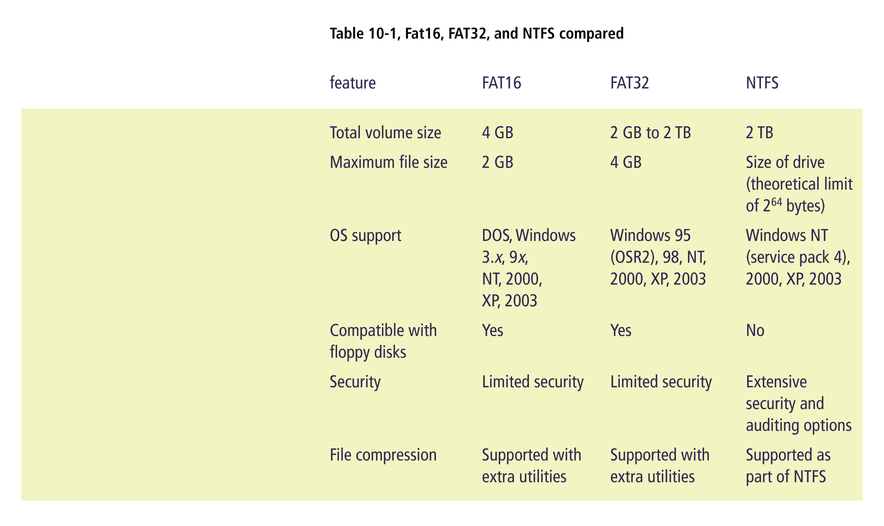

Slide 22
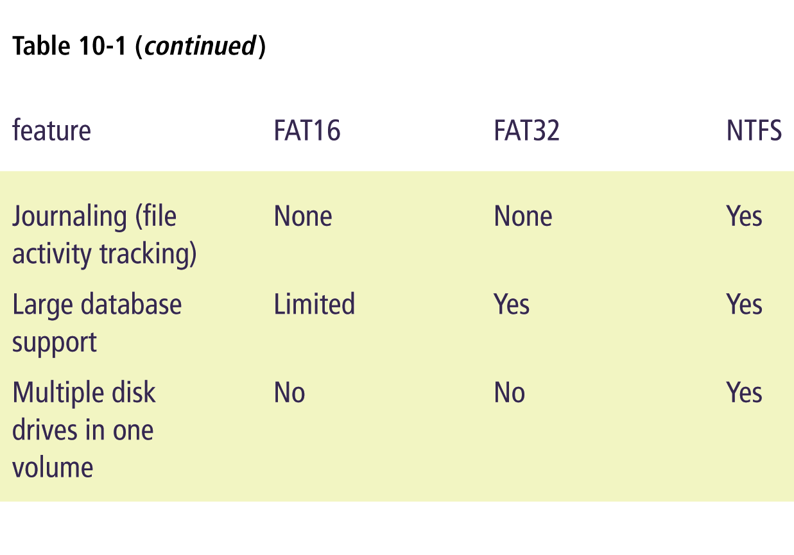

Slide 23
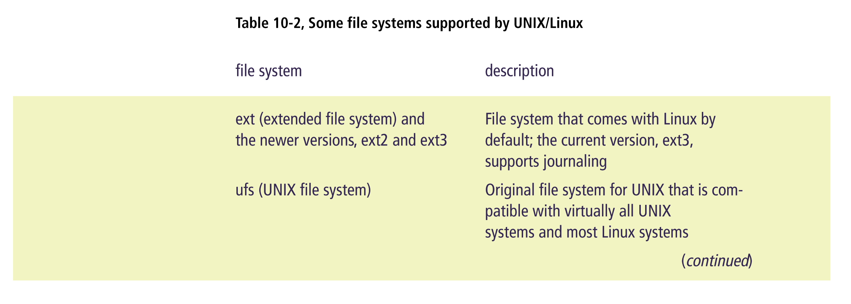

Slide 24
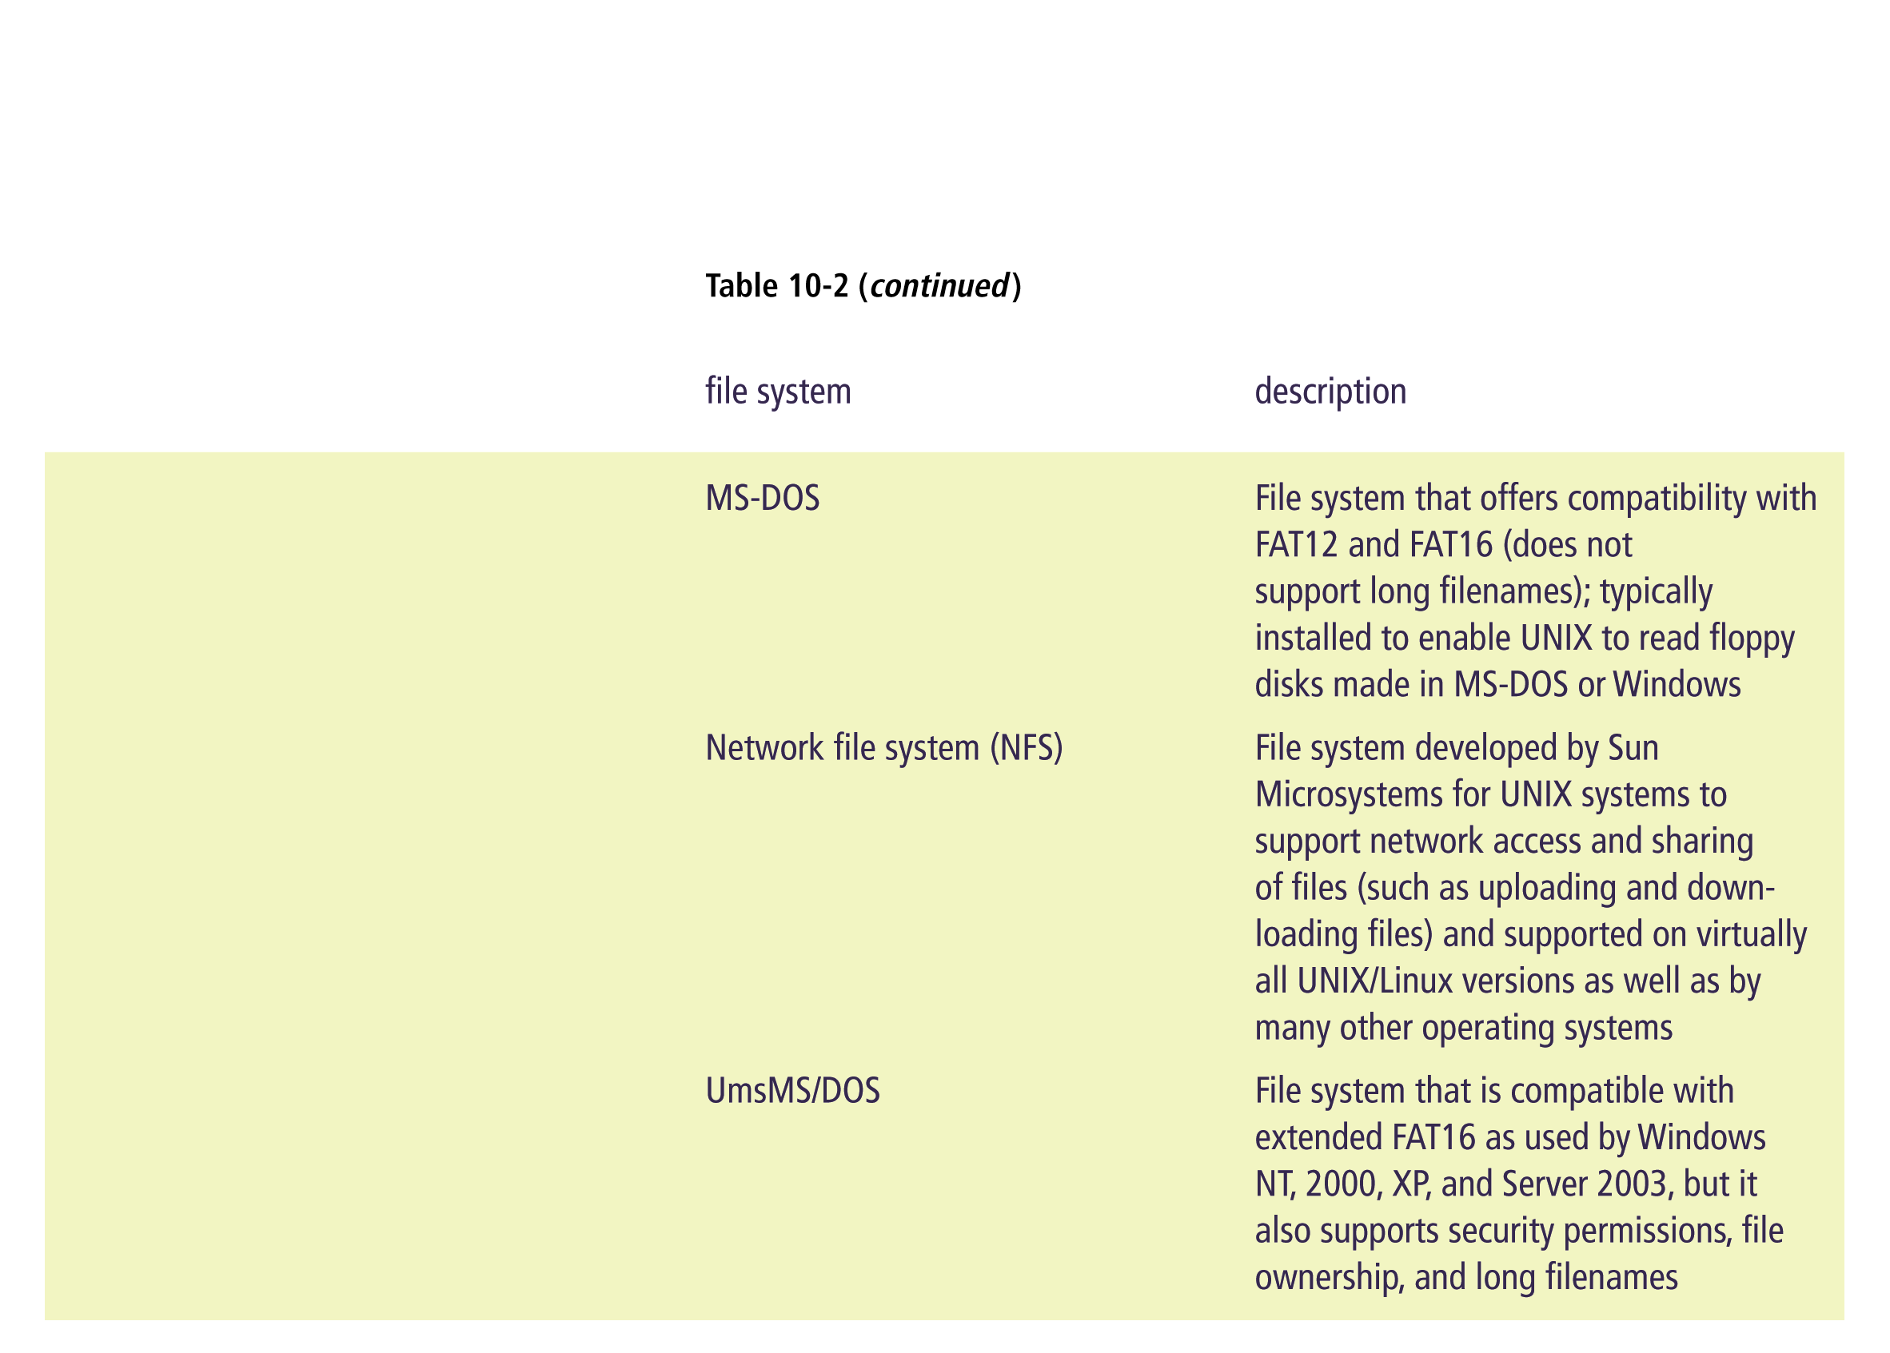

Slide 25
File Organization
Binary or text
  Binary files are computer readable but not human readable (i.e., executable programs, image files)
    Faster to access than text files
  Text files consist of ASCII or Unicode characters
    Easy to view and modify with application programs
Sequential or random access
  Sequential data is accessed one chunk after the other in order
  Random access data can be accessed in any order

Slide 26
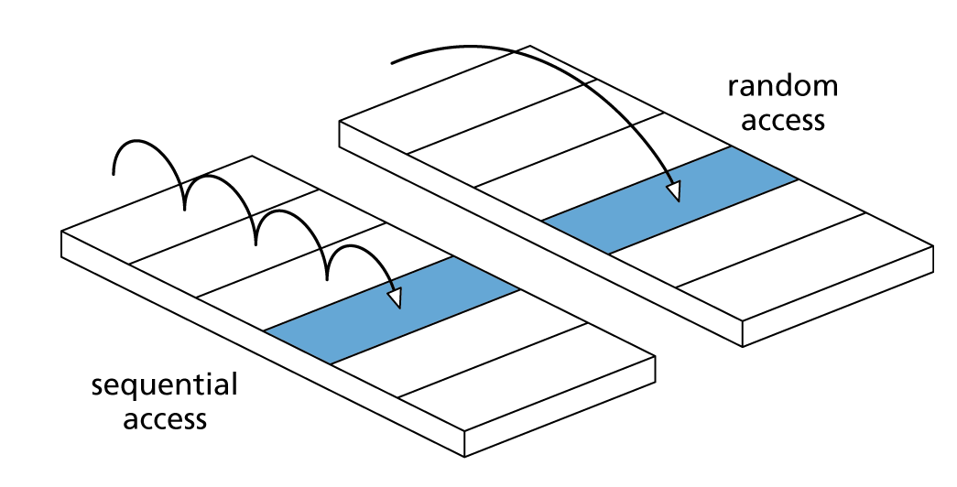
Figure 10-7
Sequential vs. random access

Slide 27
Sequential Access
Starts at the beginning of the file and processes to the end of the file
  Writing process is very fast because new data is added to the end of a file
  Inserting, deleting, or modifying data can be very slow
Can store data in rows like a database record
  Rows can have field delimiters or specify fixed sizes for each field

Slide 28
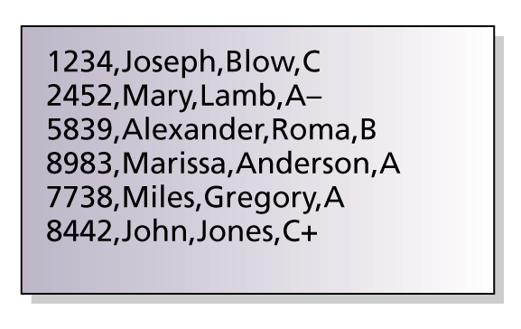
Figure 10-8
A comma can be used as a row delimiter

Slide 29
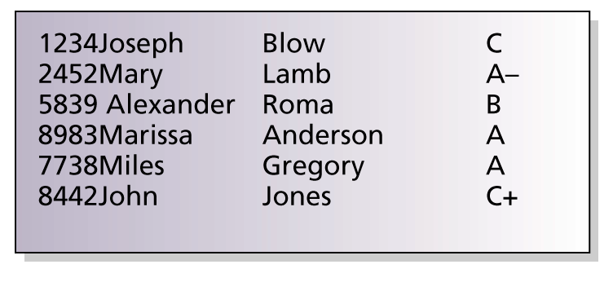
Figure 10-9
Data can also have a fixed size

Slide 30
Random Access
Provides faster access to large amounts of data
Stores fixed length records (relative records)
  Can mathematically calculate the position of the record on the disk surface
Can update records in place
May waste disk space if a record has partial or no data
Works well when a sequential record number can easily identify records

Slide 31
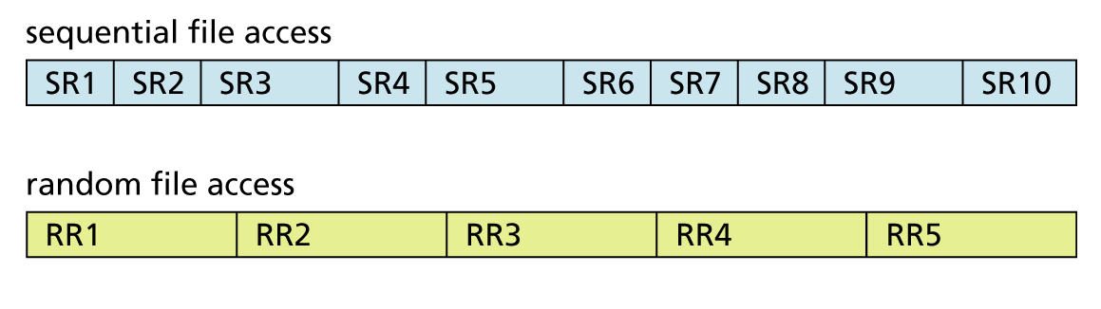
Figure 10-10
Sequential records vary in size; relative records are all the same size

Slide 32
Hashing
Used for accessing relative record files through the use of a unique value called the hash key
  Widely used in database management systems
Involves the use of a hashing algorithm to generate hash keys for each of the records
  The hash key establishes an index to a row or record of information

Slide 33
Why Hash?
Allows a key field number that is not suited for relative file access to be converted into a relative record number that can be used
Example: using phone numbers as keys in a customer information table
  Divide the highest possible phone number by the expected number of customers to get the hash key
    9999999999 / 2000 (estimated number of customers) = approximately 5,000,000
    Phone number 7025551234 / 5,000,000 gives the record number 1045

Slide 34
Why Hash? (continued)
Hashing may result in collisions
  The same relative key is generated for more than one original key value
  One solution: expand the algorithm to add the sum of the digits of the phone number to the relative key
    The sum of the digits in phone number 7025551234 is 34
    Original key 1045 + 34 gives 1079
    Lessens collisions, but does not eliminate them

Slide 35
Dealing with Collisions
Even the best hashing algorithm will have collisions
One solution is to create an overflow area
  Records with duplicate record numbers are placed in the overflow area at the end of the file
  Record retrieval
    Hash key is calculated and record is retrieved
    If the record at that location is the desired one, then the overflow area is searched sequentially until matching record is found

Slide 36
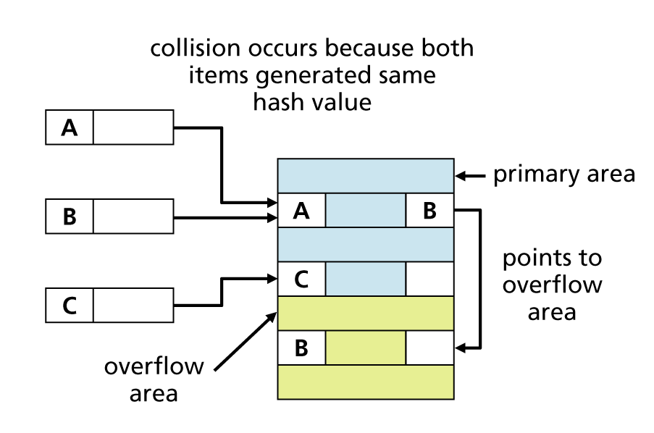
Figure 10-11
An overflow area helps resolve collisions

Slide 37
Hashing and Computer Science
Having an efficient hashing algorithm is important to companies that produce database management systems
Many different hashing algorithms are used in computer science
  Encryption and decryption
  Indexing
  Many programming languages have specialized libraries of built-in hashing routines

Slide 38
Summary
A hard drive is an example of a random access device
  Stores information in tracks and sectors
  Accesses data through read/write heads
File system: responsible for creating, manipulating, renaming, copying, and removing files from a storage device
Windows uses either FAT or NTFS as the file system

Slide 39
Summary (continued)
FAT keeps track of which files are using specific clusters
  Vulnerable to disk fragmentation
NTFS uses a master file table (MFT) to keep track of the files and directories on a volume
  Used with Windows 2000, XP, and 2003
NTFS has many advantages over FAT
  Better reliability and security, journaling, file encryption, and file compression

Slide 40
Summary (continued)
Linux can be used with many file systems
  XFS, JFS, ReiserFS, and ext3
A file contains data that is either binary or text (ASCII)
Data is usually stored and accessed either sequentially or randomly (relative access)

Slide 41
Summary (continued)
Hashing is a common method for accessing a relative file
  Involves a hashing algorithm to generate a hash key value used to identify a record location
Collisions occur when the hash key is duplicated for more than one relative record location
Goal of hashing
  To create an algorithm that allows a key field to be converted into a relative record number with a small number of collisions

